Slide 1
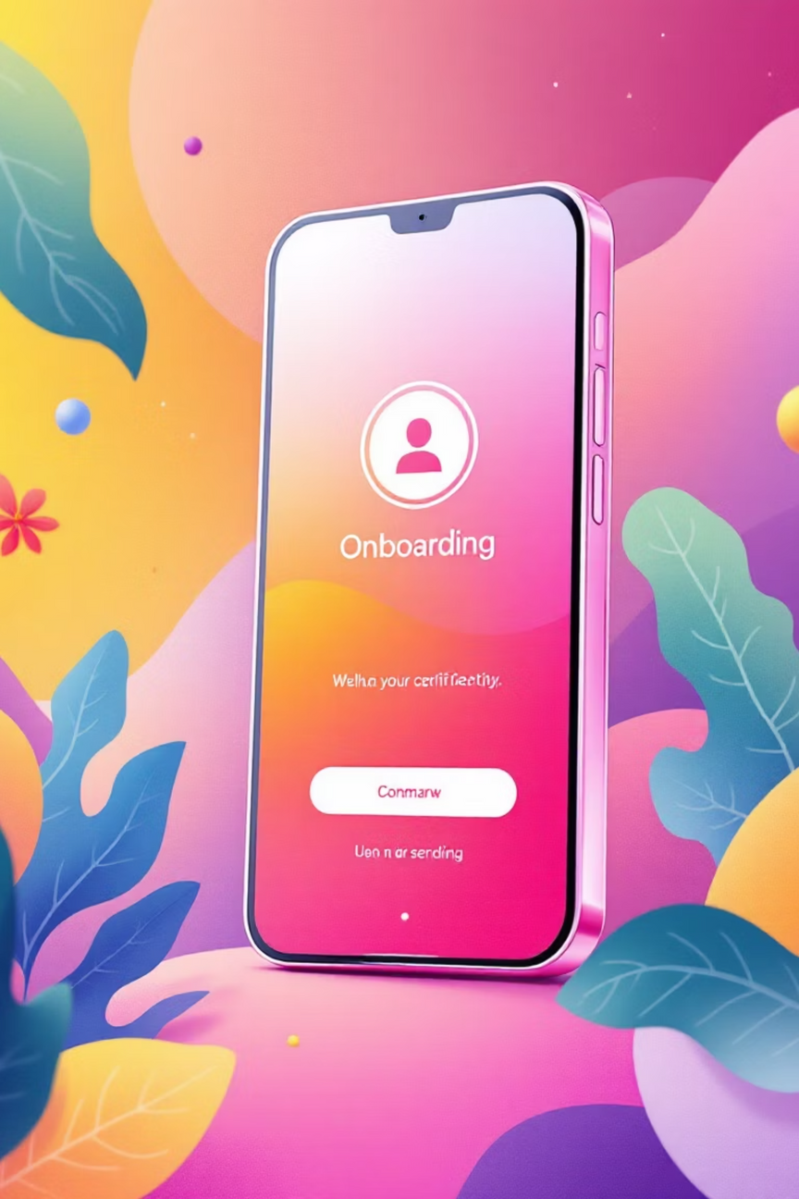
Digital KYC Verification System
A secure, automated, and user-friendly solution to revolutionize customer onboarding in finance.
Presented by RISHAV BORA

Slide 2


The Digital KYC Challenge
Know Your Customer (KYC) verification is essential for financial services, yet the digital onboarding journey is plagued by inefficiencies.
High Rejection Rates
Customer Abandonment
Slow Processing
Poor document quality, wrong uploads, and fraud attempts lead to significant abandonment.
Manual verification is time-consuming, expensive, and prone to human error.
Lack of real-time feedback and unclear rejection reasons frustrate users, leading to drop-offs.

Slide 3

Current KYC Pain Points
Poor Image Quality
Incorrect Submissions
Blurry scans
Uploading wrong document types (e.g., Aadhaar instead of PAN)
Dark or excessively glared images
Low resolution documents
Mislabeling documents (e.g., passport photo as address proof)
These issues frequently cause backend operators to reject submissions.
Leads to automatic rejection and user frustration.

Slide 4

Addressing Fraud & Operational Burden
Duplicate Submissions & Fraud
High Manual Verification Load
Attempts to submit fraudulent documents
Operators manually inspect and validate documents
Repeated submissions by the same user with minor changes
Cross-referencing documents against databases
Banks struggle to detect and prevent these fraudulent activities early.
This labor-intensive process is a major bottleneck, increasing costs and errors.

Slide 5




Our Smart Digital KYC Solution
We developed an intelligent portal that automates and secures the KYC process.
Pre-upload Validation
Automated Data Extraction
Ensures document quality before submission, reducing rejections.
OCR extracts critical information like PAN/Aadhaar numbers.
Proactive Fraud Detection
Live Selfie Authenticity
Identifies duplicate entries and mismatches instantly.
Confirms the user's presence and identity in real-time.

Slide 6






End-to-End Workflow: Seamless & Secure
Select Document
System Validation
OCR & Name Match
Duplicate Check & Selfie
Submit to Storage
Real-time feedback: Users receive immediate guidance on document quality.
Automated checks: OCR and name matching prevent incorrect submissions.
Enhanced security: Live selfie and duplicate checks fortify fraud prevention.

Slide 7





Core Modules: How It Works
Document Quality Validation
Detects blur, checks brightness, verifies resolution (min 800x600px). Instant rejection of poor uploads.
OCR Extraction (Tesseract)
Extracts and identifies critical data (PAN, Aadhaar) to ensure document correctness.
Duplicate Detection
Searches the database for existing document numbers, preventing fraud and resubmissions.
Selfie Capture + Identity
Uses webcam API to confirm the presence of a real person.
Secure Storage
Cloudinary stores documents safely; MongoDB Atlas handles structured KYC metadata.

Slide 8
Real Banking Impact & Advantages
Reduced Rejection Rate
Faster Processing
Lower Operational Cost
Eliminates poor uploads and incorrect proofs at the source, streamlining the process.
Automated validation and feedback save significant operator time, accelerating KYC completion.
Reduced manual verification translates directly into cost savings for financial institutions.
Higher Customer Conversion
Enhanced Fraud Protection
A frictionless and transparent KYC journey significantly increases onboarding success.
Proactive duplicate checks and identity verification rules fortify security and compliance.

Slide 9
Scalable Technology Stack
Layer
Tech Used
Reason
Frontend
React + Vite
Fast UI, smooth user experience
Styling
TailwindCSS
Clean, modern banking UI
OCR
Tesseract.js
Robust text extraction from images
Backend
Node.js + Express
Lightweight and scalable API
Database
MongoDB Atlas
Flexible schema, cloud-native
Storage
Cloudinary
Secure and CDN-based asset management
Deployment
Vercel + Render
Reliable cloud deployment

Slide 10



Conclusion: A Modern KYC Solution
Technically Sound
Robust architecture ensures reliability and performance.
Secure & Scalable
Built with security best practices and designed for growth.
Industry Applicable
Directly addresses the needs of banks and fintechs.
User-Centric
Dramatically improves the customer onboarding experience.
This Digital KYC system is poised to reduce drop-offs, combat fraud, and drive digital transformation in financial services.

